Slide 1

Style transfer using cnn
BY:
Mohammed Amein 211320
Soha Ashraf 205001

Slide 2

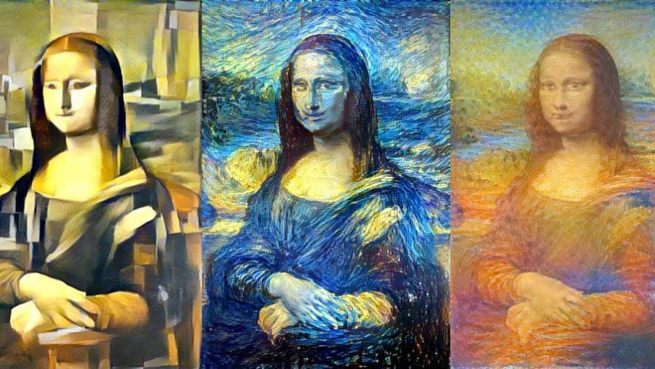
Introduction
optimization technique used to take two images—a content image and style reference image (such as an artwork by a famous painter)—and blend them together so the output image looks like the content image, but “painted” in the style of the style reference image

Slide 3

Environment and tools
We used colab as the development environment and used tools like pytorch, tensorflow,keras and numpy

Slide 4
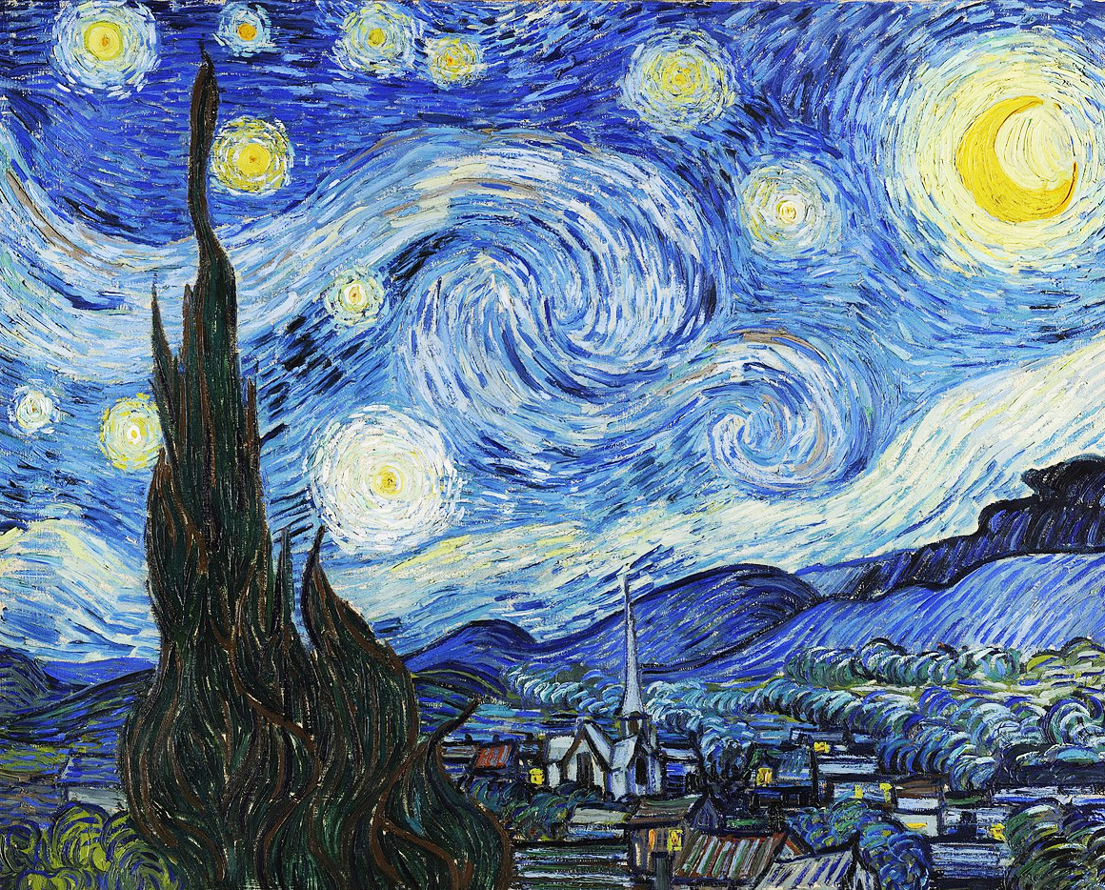
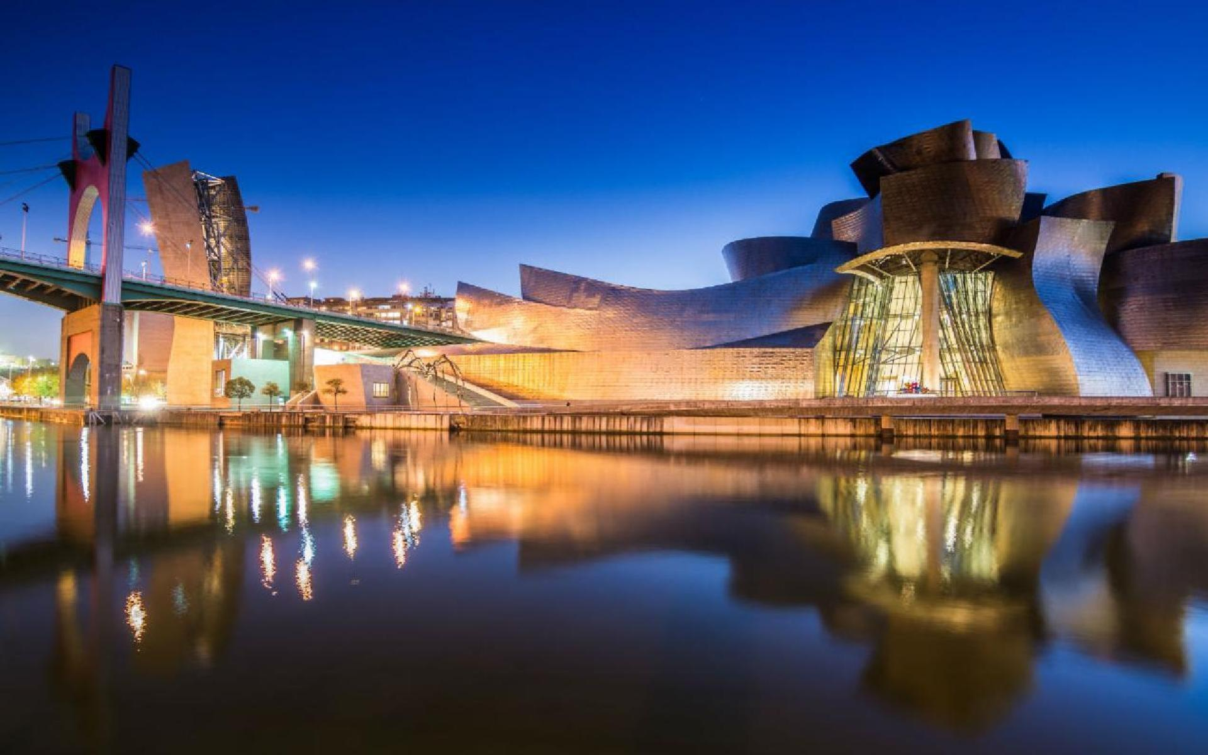
How it works
Convey the style
Keep the base photo structure

Slide 5
Literature Review

Slide 6
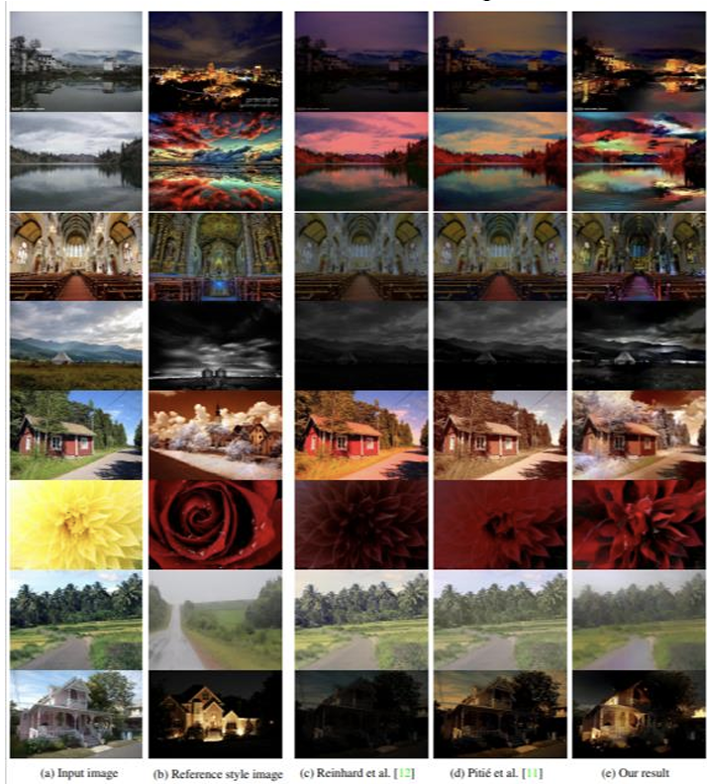
Paper 1: Neural Painters: A learned differentiable constraint for generating brushstroke paintings
The approach is done using deep learning algorithm that handles a large variety of image content while accurately transferring the reference style.
The paper didn't use any evaluation matrices or benchmarks instead it relied on users feedback where the users score images on a 1-to-4 scale ranging from “definitely not photorealistic” to “definitely photorealistic”. The paper used 8 different scenes for each of the 4 methods for a total of 32 questions .

Slide 7
Paper 2: Neural Painters: A Learned Differentiable Constraint Generating Brushstroke Paintings
Training neural painters using VAEs and GANs and combining them with style transfer to create images.
The paper discussed a new approach to perform style transfer instead of optimizing the loss of semantic meaning and reference style on works on minimizing semantic loss while brushstrokes are generated this way keeps the main part of the photo giving a delusion that the photo structure is correct.

Slide 8
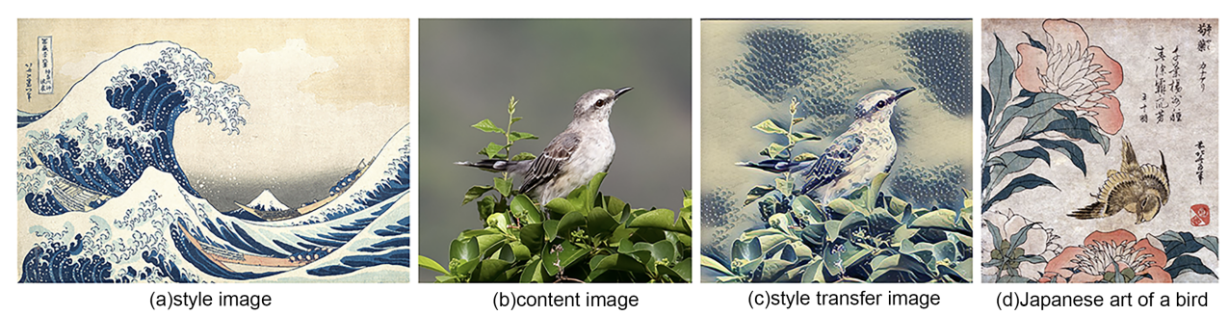
Paper3: Neural Artistic Style Transfer with Conditional Networks.
The authors introduced in this paper two novel approaches of semi supervised learning.
The first approach used a GAN- based style transfer model that capable of transferring more than one style of the images.
The second approach used NST that can understand how the transfer the image into the artist style.
The second approach is applicable to many tasks and train on a lower parameter space than the cGAN model.

Slide 9
Paper4: Stylistic Image Generation with Neural Style Transfer.
the authors introduced a class deep neural networks that can compute the tasks of image processing in the CNN.
In the first method, the authors build the model of the architecture from scratch and used this model to generate and evaluate the modified images.
In the second method, the authors used the tensorFlow Hub pre-trained model for generating a combination of two images to create a new generated image.

Slide 10
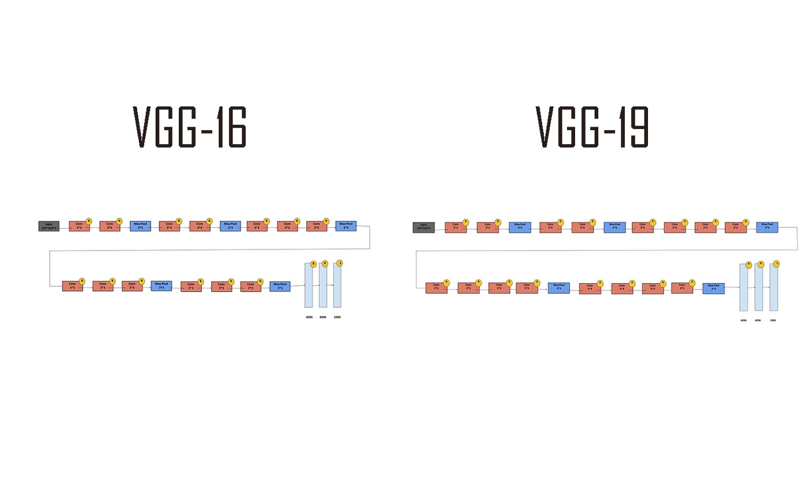
models

Slide 11
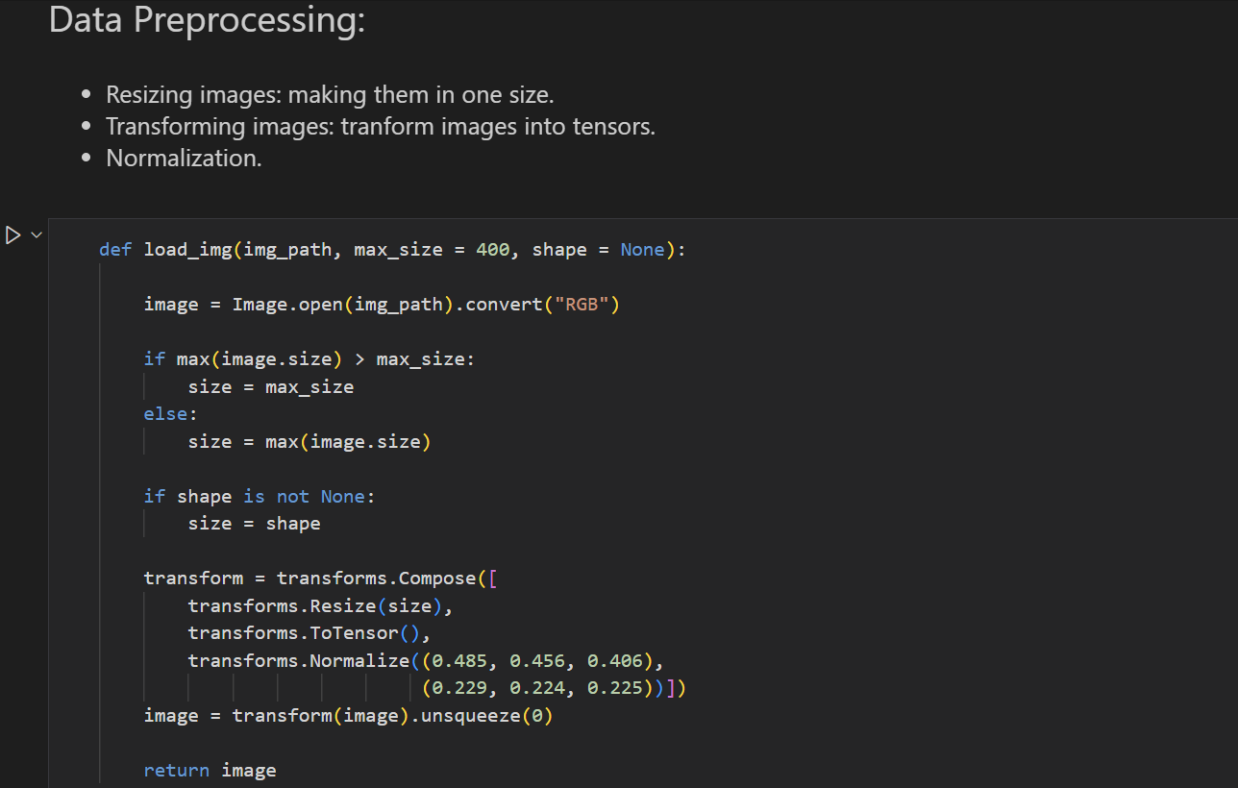
Pre-processing
Resize all the used images to make them the same size and reduce the big size of image. Transforming images into tensors.

Slide 12
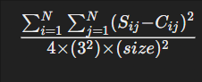
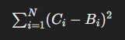
Loss functions
Content loss to ensure the models saves the original image structure
Ci​ represents the 𝑖𝑡ℎith pixel value of the combination image.
𝐵𝑖Bi​ represents the 𝑖𝑡ℎith pixel value of the base image.
𝑁N is the total number of pixels in the images.
Style loss to ensure the model follows the given style
S ij ​ represents the element at row 𝑖 i and column 𝑗 j of the Gram matrix of the style image.
𝐶 𝑖 𝑗j ​ represents the element at row 𝑖 i and column 𝑗 j of the Gram matrix of the combination image.
𝑁 is the total number of elements in the matrices, which is the square of the size of the images.

Slide 13
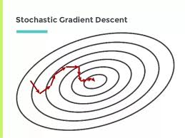
optimiazation
stochastic gradient descent (SGD) with an exponential decay learning rate schedule learning rate starts at 100.0 and decays exponentially with a decay rate of 0.96 every 100 steps

Slide 14
results

Slide 15
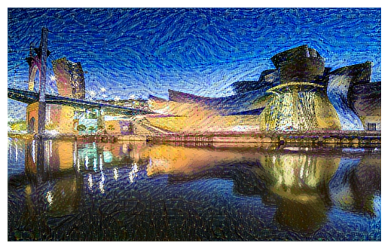
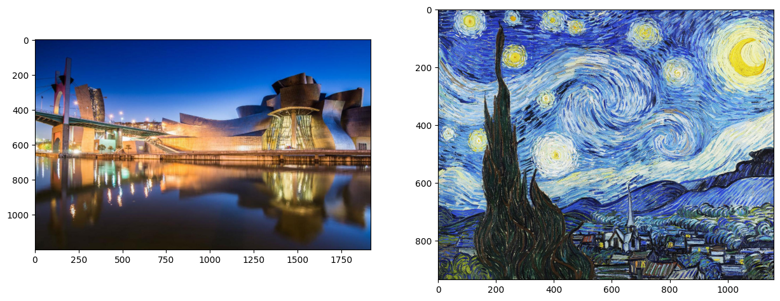
VGG 19 Results

Slide 16
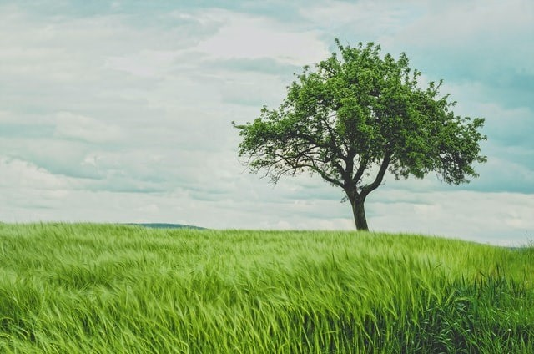
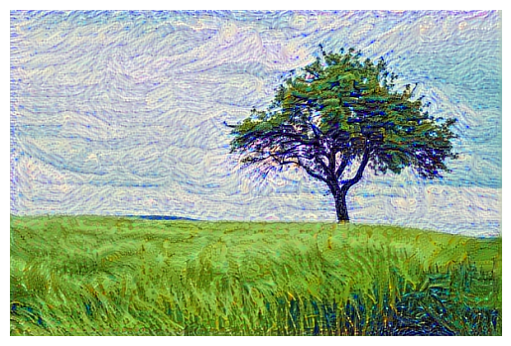
VGG 19 Results

Slide 17
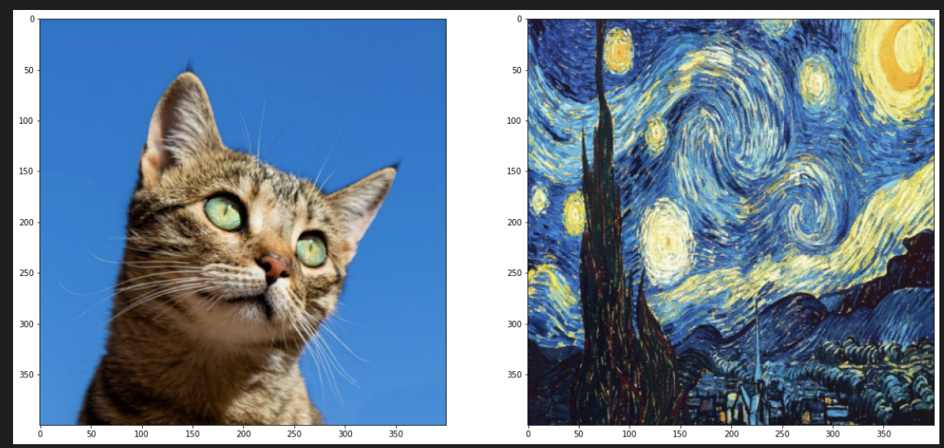
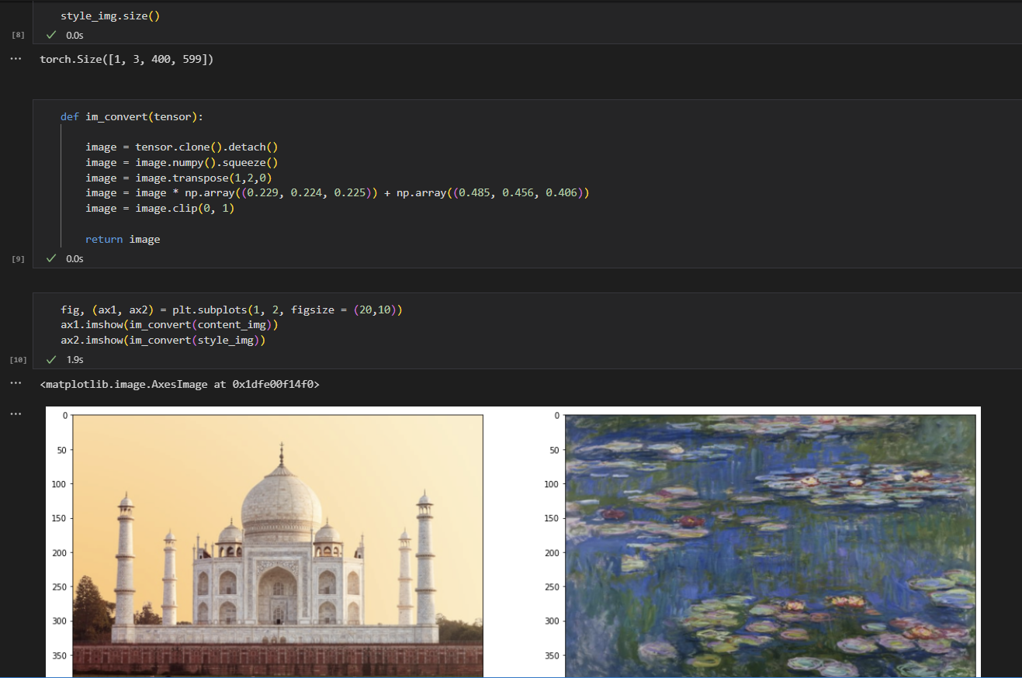
VGG 16

Slide 18
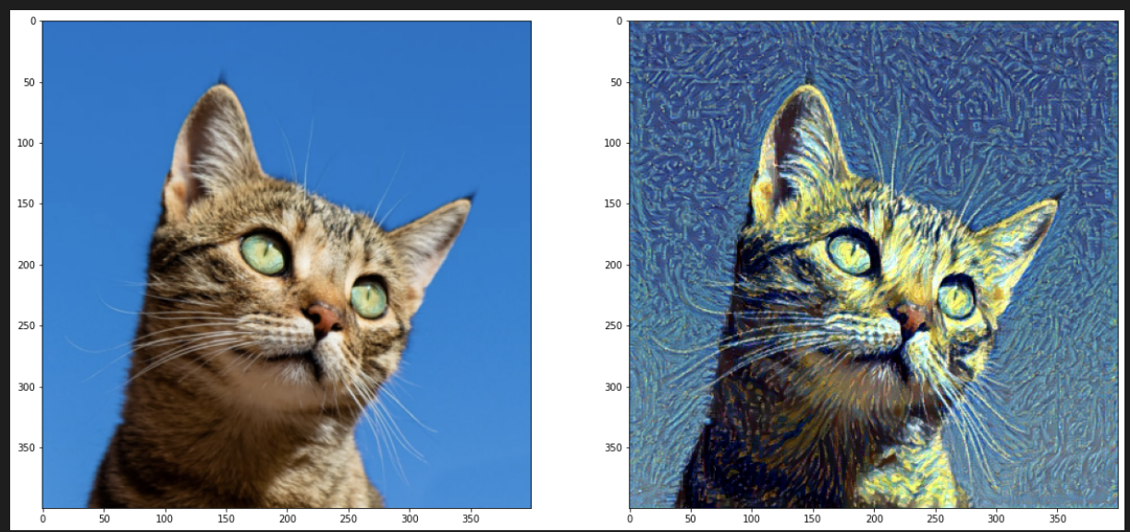
VGG 16 Results

Slide 19
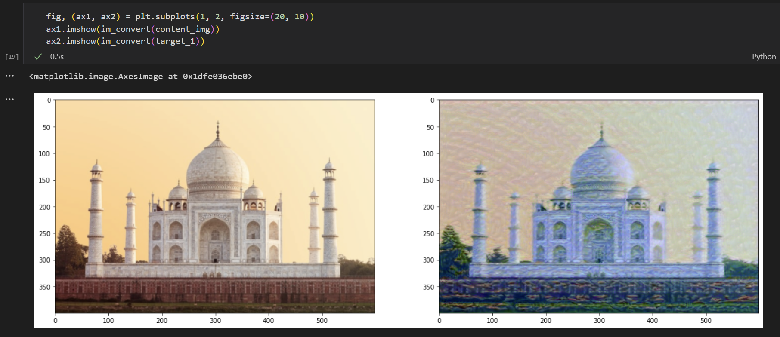
VGG 16 Results

